Slide 1


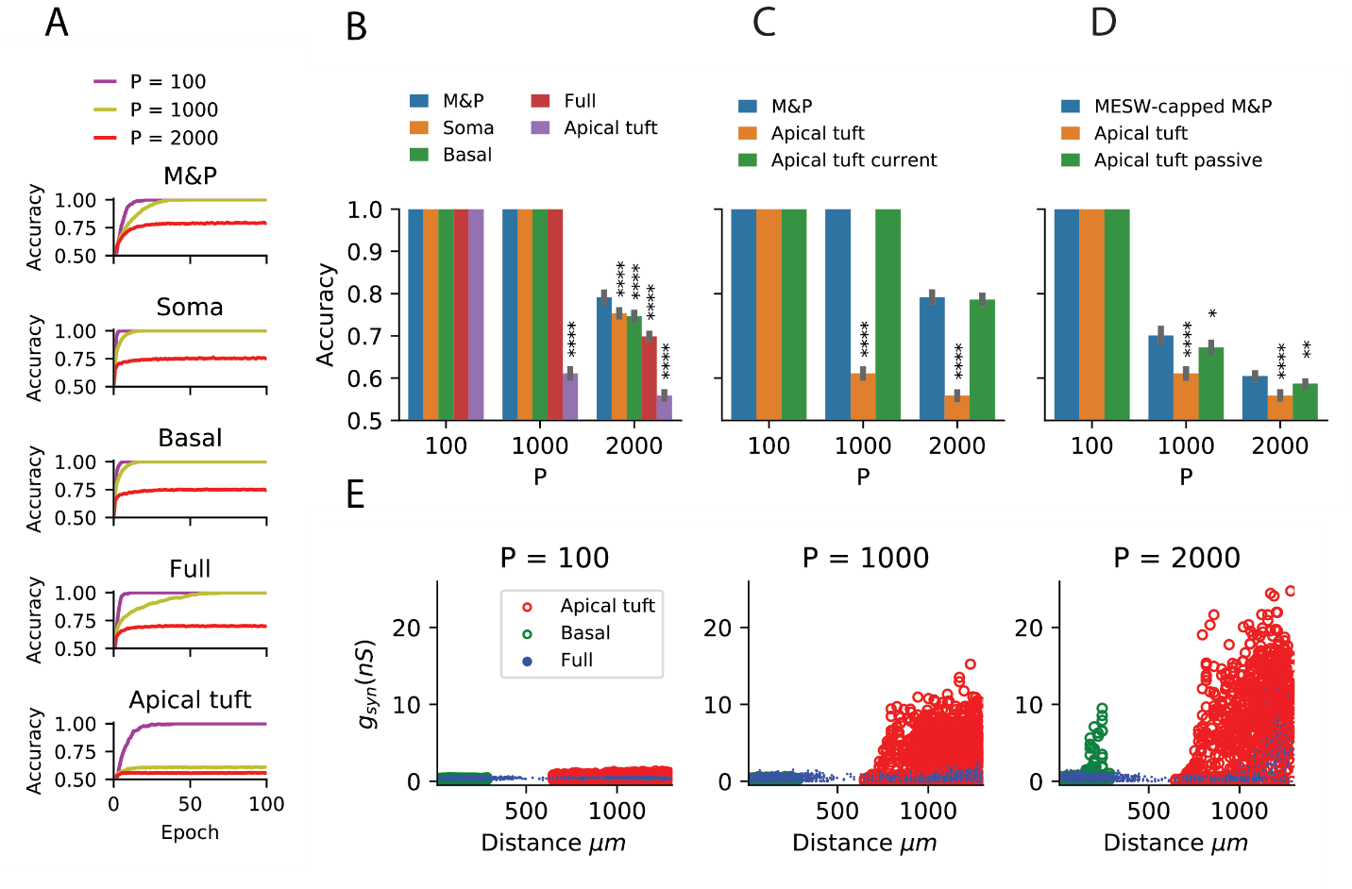
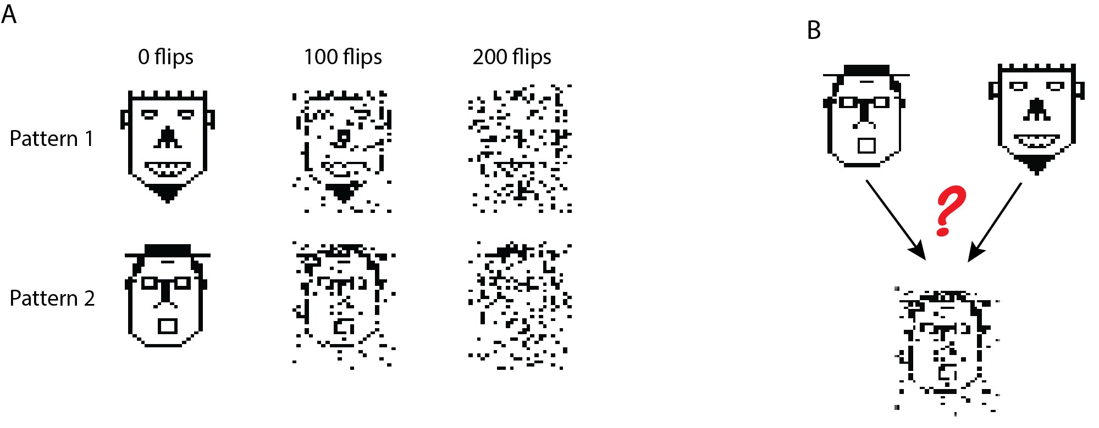
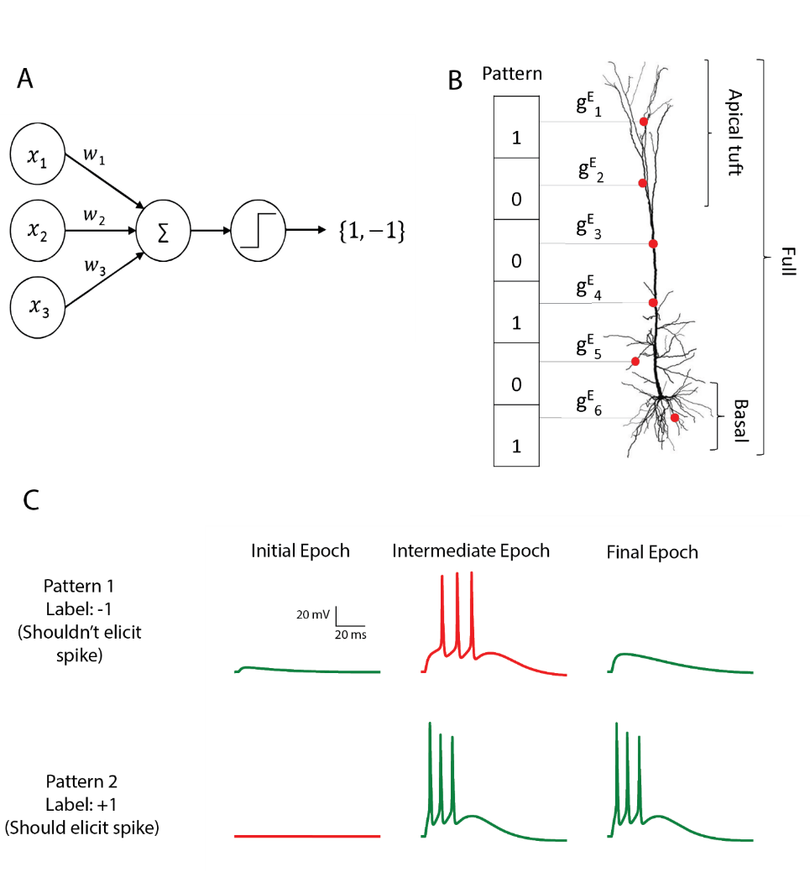
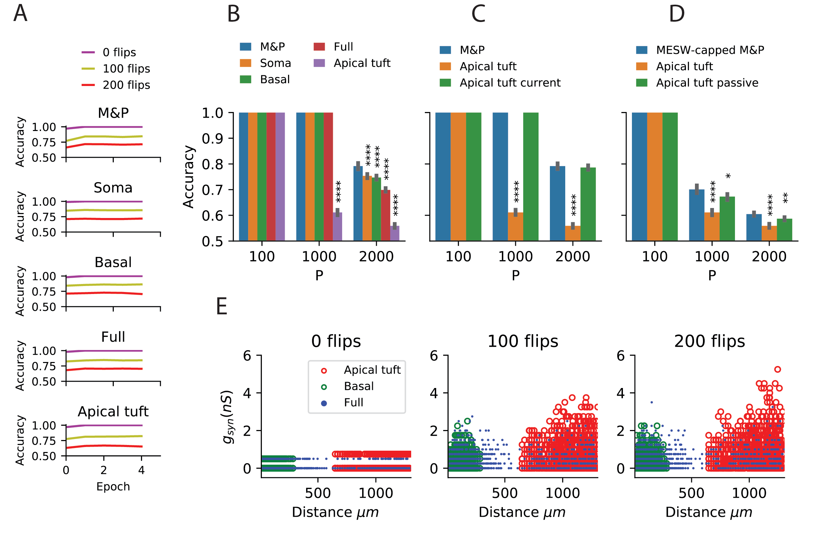
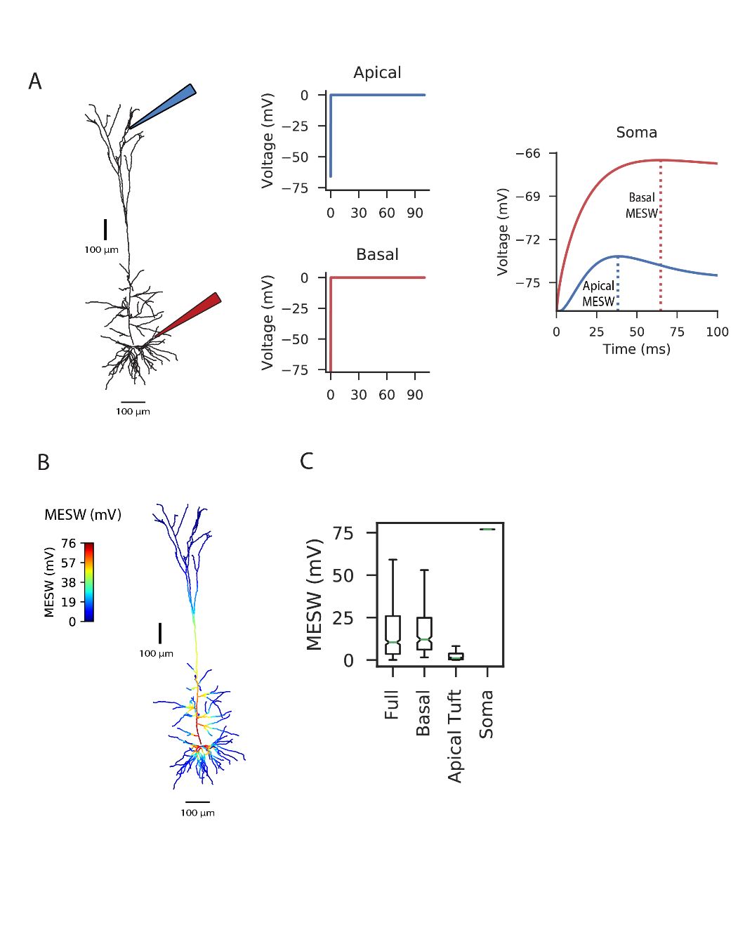
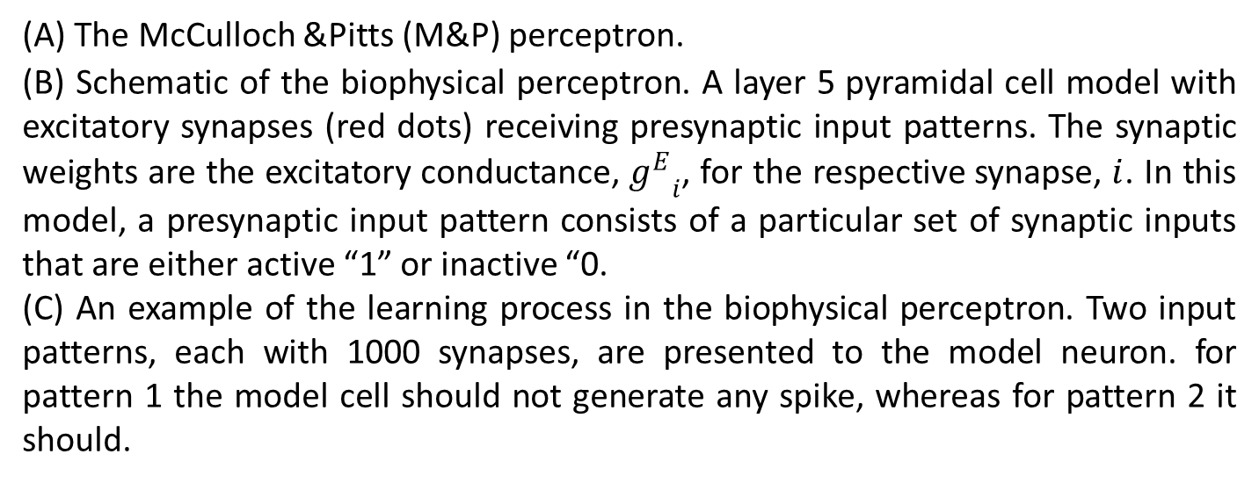
Towards a Biophysical Perceptron
¹Toviah Moldwin, ^{1,2}Idan Segev
¹The Edmond and Lily Safra Center for Brain Sciences, ²The Department of Neurobiology, The Hebrew University of Jerusalem, Israel
Biorxiv: Perceptron learning and classification in a modeled cortical pyramidal cell
Abstract
Memorization Task Performance
Generalization Task
The perceptron learning algorithm and its multiple-layer extension, the backpropagation algorithm, are the foundations of the present-day machine learning revolution. However, these algorithms utilize a highly simplified mathematical abstraction of a neuron; it is not clear to what extent real biophysical neurons with morphologically-extended nonlinear dendritic trees and conductance-based synapses could realize perceptron-like learning. Here we implemented the perceptron learning algorithm in a realistic biophysical model of a layer 5 cortical pyramidal cell. We tested this biophysical perceptron (BP) on a memorization task, where it needs to correctly binarily classify 100, 1000, or 2000 patterns, and a generalization task, where it should discriminate between two “noisy” patterns. We show that, for most cases, the BP performs these tasks with an accuracy comparable to that of the original perceptron. We concluded that cortical pyramidal neurons can act as powerful classification devices.
(A) Adding noise via “bit flips” for the generalization task. Two patterns (leftmost column, clean faces) consisting of 200 active synapses (black pixels) and 800 inactive synapses (white pixels) can be corrupted by flipping active synapses to an inactive synapses or vice versa, creating a new “noisy” pattern (middle and right columns).
(B) Task schematic. A noisy pattern, drawn from one of two original patterns is presented to the neuron. The neuron has to decide which of the original patterns the noisy pattern came from, by either firing (for the first pattern) or not firing (for the second pattern).
The Perceptron
(A) Learning curves for the memorization task, in which a neuron with 1000 synapses had to classify patterns (half of which should produce a spike, half shouldn’t) in the fully active L5PC perceptron and in an M&P perceptron for different numbers of patterns (P, colored traces) and different conditions of synaptic placement in the L5PC model.
(B) Accuracy for the memorization task for different synaptic placement conditions. Mean accuracy after 100 epochs is shown for all synaptic placement conditions (error bars: standard deviation) for different numbers of patterns (P). The blue bar within each grouping shows the performance of a M&P neuron on a task with the same number of patterns.
(C) Effect of conductance synapses vs. current synapses on classification capacity in the apical tuft.
(D) Effect of MESW-constraint and active dendritic mechanisms on classification performance.
(E) Value of synaptic conductances obtained after the completion of the learning algorithm as a function of distance of the synapses from the soma for learning tasks with different numbers of patterns.
Generalization Task Performance
(A) The McCulloch &Pitts (M&P) perceptron.
(B) Schematic of the biophysical perceptron. A layer 5 pyramidal cell model with excitatory synapses (red dots) receiving presynaptic input patterns. The synaptic weights are the excitatory conductance, ${g^{E}}_{i}$, for the respective synapse, $i$. In this model, a presynaptic input pattern consists of a particular set of synaptic inputs that are either active “1” or inactive “0.
(C) An example of the learning process in the biophysical perceptron. Two input patterns, each with 1000 synapses, are presented to the model neuron. for pattern 1 the model cell should not generate any spike, whereas for pattern 2 it should.
Maximum Effective Synaptic Weights
(A) Learning curves for the generalization task, in which a neuron with 1000 synapses had to distinguish between two patterns with noise added in the form of random “bit flips”, in the fully active L5PC perceptron and in an M&P perceptron for different numbers of bit flips and different conditions of synaptic placement in the L5PC model.
(B) Accuracy for the generalization task for different synaptic placement conditions. Mean accuracy after 20 epochs is shown for all synaptic placement conditions (error bars: standard deviation) for different levels of noise (numbers of bit flips). (C) Effect of conductance synapses vs. current synapses on classification capacity in the apical tuft. As in (B), blue bar is the performance of an M&P neuron for comparison. (D) Effect of MESW-constraint and active dendritic mechanisms on classification performance.
(E) Value of synaptic conductances obtained after the completion of the learning algorithm as a function of distance of the synapses from the soma for different numbers of bit flips.
The Perceptron Learning Algorithm
We have a set of input patterns {x^{µ} = [x₁...x_{N}]}, 𝜇 = 1...M. Each pattern is assigned a label y^{µ} ∈ {+1,-1} .
The neuron’s response to a given pattern x^{µ} given its current weight vector, w is defined by the formula ŷ = sign(w^{T}x^{µ}). We would like the neuron’s response to each pattern, ŷ^{µ} , to be equivalent to y^{µ}. To ensure that this occurs, the neuron updates its weights in the following manner (η is a fixed learning rate).
While epoch < max_epochs
For each pattern x^{µ} :
If sign(w^{T}x^{µ}) == y^{µ}, do nothing.
Otherwise update the weights:
w ← w + ηx^{µ}y^{µ}
For example, we might have the pattern x¹ = [1 0 0 1] which is assigned the label y¹ = +1. If the perceptron’s current weight vector is w = [-2 3 4 1], the output of the neuron will be sign(w^{T}x¹) = sign(-1) = -1. The output is incorrect, so we update the weight vector by adding the pattern to the weight vector, giving us w = [-1 3 4 2]. The neuron now outputs sign(w^{T}x¹) = sign(1) = +1, so the pattern is correctly classified.
Conclusions
It is possible to implement the perceptron learning algorithm in a detailed L5PC model.
Placing all synapses on the apical tuft reduces the memorization capacity of the perceptron, although it does not seem to have a major effect on its robustness to noise in a generalization task.
The reason for the reduced memorization capacity in the apical tuft placement condition is due to the maximum effective weights of the apical tuft synapses. Because the local voltage is ‘capped’ by the sodium reversal potential, the maximum voltage that the soma ‘sees’ from a distal location – the maximum effective synaptic weight (MESW) - depends on the sodium reversal potential and the attenuation factor.
It may be possible to increase capacity by treating different regions of the neuron as separate computational units that use dendritic nonlinearities to communicate their outputs to each other.
(A) To calculate the MESW for each location, we voltage clamp the dendritic segment to 0 mV, the reversal potential for sodium, for 100 ms (middle column) and record the somatic voltage (right column).
(B) A simulated L5 PC superimposed with the MESW values.
(C) Box-and-whiskers plot of MESWs when the synapses are placed on the full dendritic tree, basal tree, apical tuft, and soma
Contact
References
Toviah Moldwin
The Edmond and Lily Safra Center for Brain Sciences
The Hebrew University of Jerusalem
Email: tmoldwin@gmail.com
Rosenblatt, F. (1958). The perceptron: A probabilistic model for information storage and organization in the brain. Psychological Review, 65(6), 386–408.
Hay, E., Hill, S., Schürmann, F., Markram, H., & Segev, I. (2011). Models of neocortical layer 5b pyramidal cells capturing a wide range of dendritic and perisomatic active properties. PLoS Computational Biology, 7(7). Amit, D. J., Wong, K. Y. M., & Campbell, C. (1999). Perceptron learning with sign-constrained weights. Journal of Physics A: Mathematical and General, 22(12), 2039–2045.
Amit, D. J., Wong, K. Y. M., & Campbell, C. (1999). Perceptron learning with sign-constrained weights. Journal of Physics A: Mathematical and General, 22(12), 2039–2045.
Chapeton, J., Fares, T., LaSota, D., & Stepanyants, A. (2012). Efficient associative memory storage in cortical circuits of inhibitory and excitatory neurons. Proceedings of the National Academy of Sciences of the United States of America, 109(51), E3614-22.

